Slide 1
Building Human Sensor Webs with SWE

Slide 2
Overview
The Human Sensor Web Project
Conventional SWE Use Cases
Mobile Communication
Realization
Outlook
Conclusion

Slide 3
The Human Sensor Web Project
Aim: Improve the water supply in Zanzibar
Problem: Often no water supply within houses → instead people need to use water points
Although the water supply is not very developed, mobile communication has a good availability

Slide 4
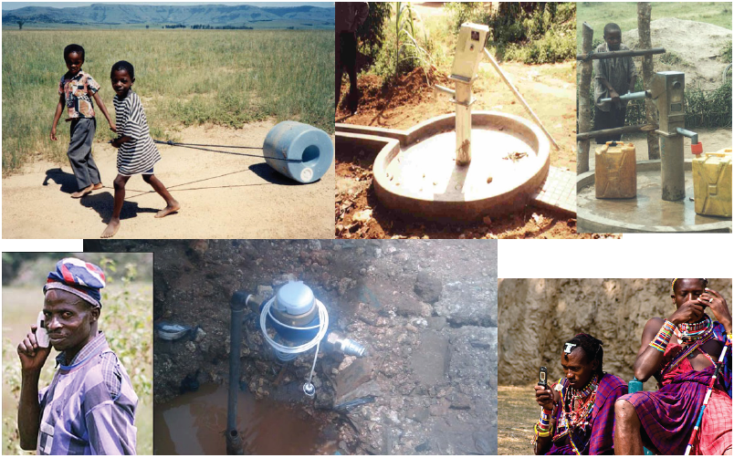
The Human Sensor Web Project

Slide 5
The Human Sensor Web Project
Idea: Using mobile phones for reporting the water supply quality at water points
Water operators receive better knowledge about the supply situation
The consumers can be informed (e.g. via SMS) if problems with the water supply occur

Slide 6
The Human Sensor Web Project
Conducted by the ITC, WI-TMC and 52° North for UN-HABITAT
Funded by Google.org
Based on SWE technology → connect simple mobile phones to the SWE architecture in order to allow the collection of human observations

Slide 7
Conventional SWE Use Cases
Sensor networks owned by operators like public authorities and companies (e.g. weather services, pollutant measurement stations)
Collection of the data and transfer into a central database
Standardized access to the database through the SOS interface

Slide 8
Mobile Communication
Mobile phones become more and more powerful
  Wireless internet connections → ability to connect to web services
  Better displays → more opportunities for designing programs running on mobile phones
  Significant amount of computing power → support of more complex communication protocols
  GPS → allows positioning

Slide 9
Mobile Communication
Adapters for SWE components may be implemented directly on mobile phones
  Using mobile phones as data collection devices
  Provide input forms to the user
  Automatically determine the position of observations
  …
But…

Slide 10
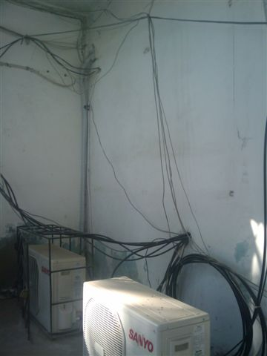
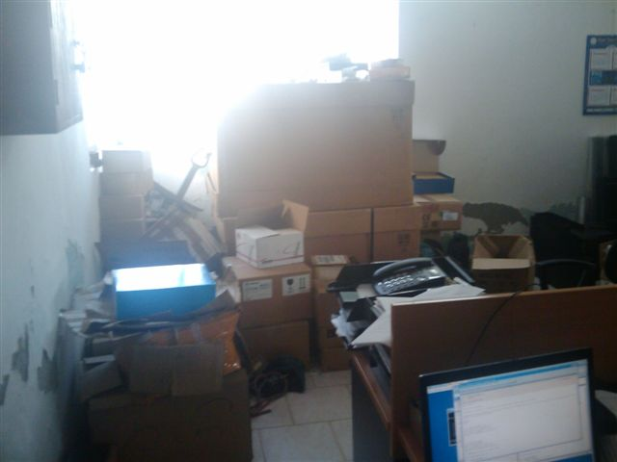
Mobile Communication

Slide 11
Mobile Communication
Mobile communication infrastructure in Africa cannot be compared to Europe
Implementing SWE on mobile phones excludes older phone models
Highly sophisticated applications are not realistic
Aim: Develop an approach that can also be supported by simple mobile phones
→ use SMS

Slide 12

Realization

Slide 13
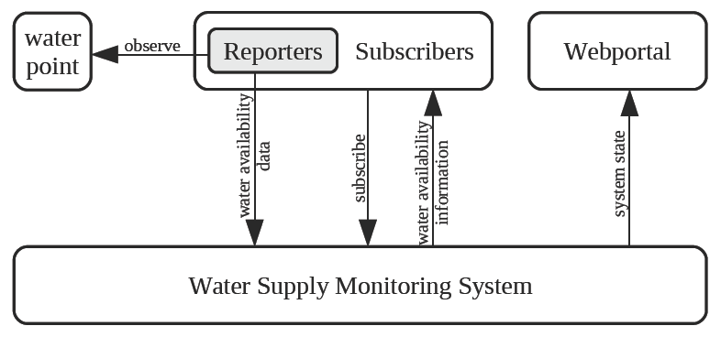
Realization

Slide 14
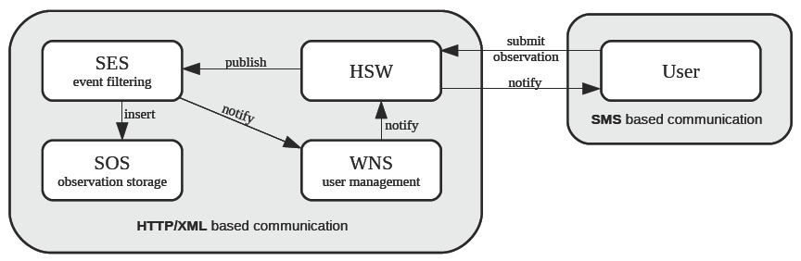
Realization

Slide 15
Realization
Human observations are not always reliable
→ need for modeling some kind of trust
Depending on the reputation of a user the system holds a message back or forwards it
Reputation is adjusted after each sent message
Principle: Fast decrease and slow increase of trust

Slide 16
Realization
Modeled using the Event Pattern Markup Language (EML, OGC discussion paper)
EML files are submitted to a SES instance
SES filters messages taking into account the calculation of trust
SES only forwards trustworthy messages

Slide 17
Outlook
Transfer the solution to further application domains
Enhance the trust model
Extended client applications

Slide 18
Conclusion
SWE concepts can be applied also to human observations
System based on 52° North SWE implementations
Trust model is important
Human observations add a new valuable data source to sensor network infrastructures
Users do not need any knowledge about SWE

Slide 19
Thank you for your attention
Further information:
jirka@52north.org
http://www.52north.org/
http://sensorweb.uni-muenster.de/

